Slide 1
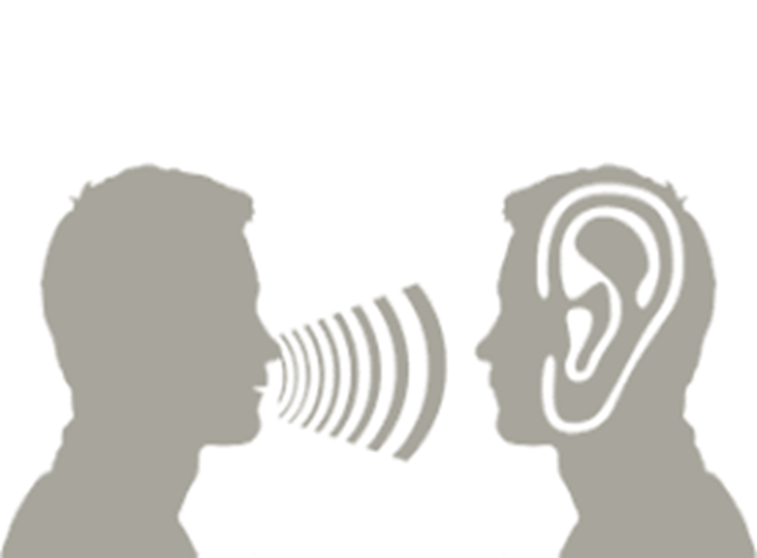
LISTENING SKILLS AND NOTE-TAKING SKILLS

Slide 2

Inspiring Quotes on Listening
“If we were supposed to talk more than we listen, we would have had two mouths and one ear” (Mark Twain, n.d).
“We have two ears and one mouth so that we can listen twice as much as we speak” (Epictetus, n.d.)

Slide 3


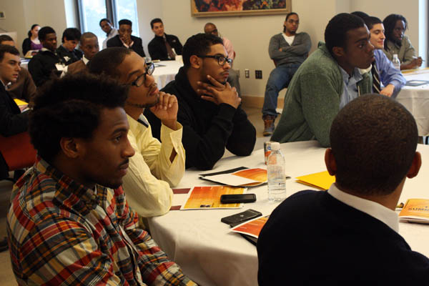
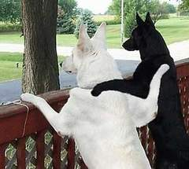
Listen!

Slide 4
A Test!
What happens when you analyse sound, organize sound into patterns, interpret sounds and infer meaning from sounds?

Slide 5
Who can repeat what I just said?

Slide 6
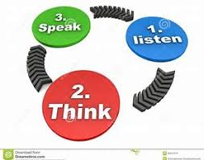
Listening…

Slide 7
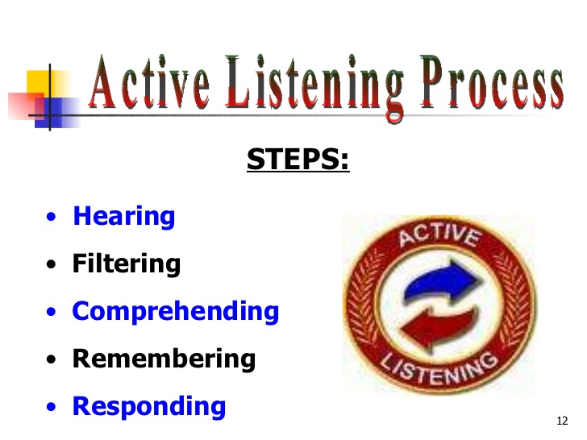
Steps to Active Listening Process

Slide 8
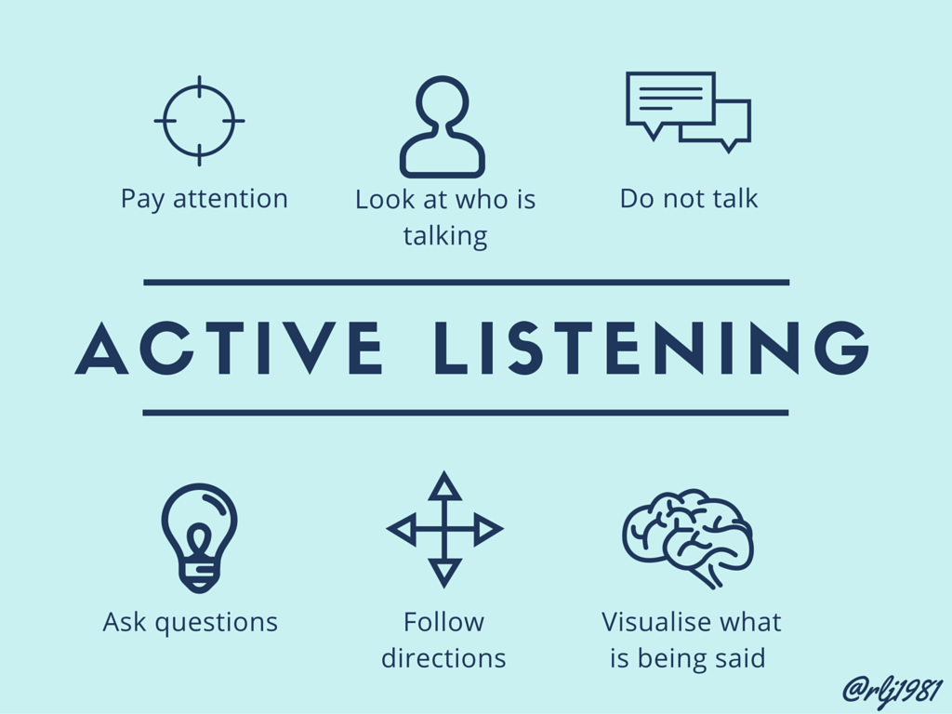
Steps to Active Listening Process contd.

Slide 9
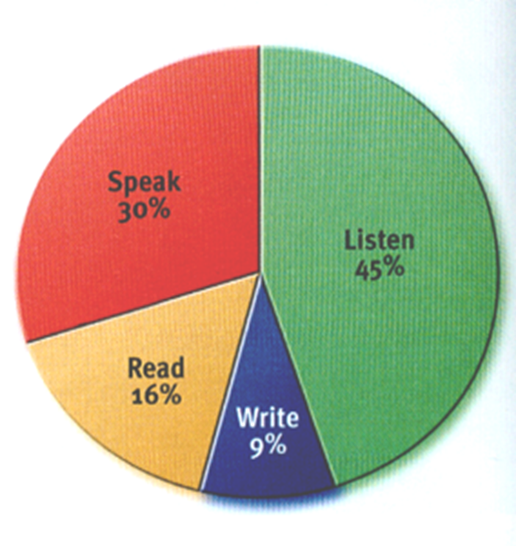
Statistics
What You Do With Your Communication Time

Slide 10
Types of listening.
Appreciative: Listening for pleasure (emotions, feelings, relaxation).
Comprehensive: Totality of messages and sub-messages from verbal and non verbal expressions.
Therapeutic or Empathetic: Attempting to understand the feelings and emotions of the speaker; no judgement, but clarification and reflection.

Slide 11

Appreciative Listening
Appreciative Listening:
Listening for pleasure and relaxation. Music, jokes, stories etc.

Slide 12

Empathic Listening
Empathetic Listening:
Listening to encourage or help the speaker.
To provide emotional support.
Doctor/patient, mother/child.

Slide 13
Comprehensive Listening
  Comprehensive Listening:
Listening to understand a speaker’s idea.
Lectures, talks, direction to a place, counsel.
Focuses on words, facial expression, gestures, vocal quality, message.

Slide 14
Levels of Listening
Hearing: Take in the stimuli (raw message) through your senses (hearing and sight).
Understanding/Processing: This engages your mind. Analyse, evaluate and synthesize.
Respond/Feedback: The speaker sees and hears what you do, he/she feels respected or cared for.

Slide 15
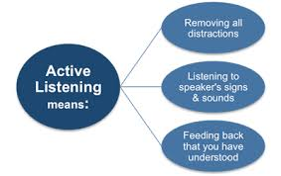
Active Listening

Slide 16
Why do we Listen?
To gain information and to learn.
To get feed back.
To share in another’s story.
To build a relationship.
To value and respect others.
To be able to help others.
To be informed.
To relax.

Slide 17
Types of listeners
Active listener: Pays attention to details from the speaker.
Pretentious listener: Feigns attention but really absent minded.
Selective listener: Picks out only what he/she wants to hear.

Slide 18




Active Listening

Slide 19
Challenges to good listening
Physical/Environmental:
Noise,
interruptions,
posture,
surrounding (dirty, smell, hot).
Psychological: Health (feeling feverish, hearing impairment).
Speaker’s disability (speech disorder, bad grammar, e.t.c).

Slide 20
Contd.
Bias or prejudice:
Gender
Racism
Religious beliefs
Estranged relationship
Anxiety:
worries,
bad news,
imminent event.

Slide 21
Contd.
Attitude:
Egocentric (I know-it-all).
Rudeness
Hostility
Timid
Intolerant,
anger,
over-excitement.
Mismatching: conceptual differences, age difference that leads to mismatch vocabulary.

Slide 22
Good Listening Tips.
How to Listen Well:
Give undivided attention and do not interrupt.
Listen to non-verbal cues.
Empathise (“you look tired, do you want to rest”?).
Respond to encourage (clap, smile, laugh, nod,).
Ask questions. “Do you mean……

Slide 23
Enabling Skills.
Understanding ability
Some set of etiquettes
Some questions for explanation
Providing suitable response
Body language
Eye contact with speaker
Sitting straight and alert

Slide 24

NOTE- TAKING SKILLS

Slide 25
Skills for good note-taking
Recognizing main ideas
Identifying what information is relevant to your task
Having a system of note taking that works for you
Reducing the information to note and diagram format
Where possible, putting the information in your own words (with Mnemonics).

Slide 26
How to improve your note-taking skills
Attend lectures regularly. Once you miss one, it will be easier to miss more.
Highlight discourse markers (words or phrases used to direct the flow of conversation, e.g., like, you know etc.)
Keep your note organized or put in folders.
Record the source of information

Slide 27
Contd.
Use bright colors to highlight points.
Separate themes and topics with new heading or paragraph.
Be alert for cues, postural, visual, etc.
Record examples where helpful.
Keep the notes for one class separate from other classes.

Slide 28
Contd.
Leave blanks where information is missed or not understood. Fill in gaps after lecture.
Use symbols such as asterisks for emphasis.
Practice five-minute review of your note after lecture.

Slide 29
Sources
Epictetus. (n.d.). AZQuotes.com. Retrieved January 12,
2022, from AZQuotes.com Web site:
https://www.azquotes.com/quote/90291
Mark Twain. (n.d.). AZQuotes.com. Retrieved January 12,
2022, from AZQuotes.com Web site:
https://www.azquotes.com/quote/547855
Vijay, J. (2013). Listening Skills. Retrieved from:
http://www.slideshare.net/srivijayj/listening-
skills-24910223

